Slide 1


A Mobile App For Collection Of Users Experience Data
From Mobile Network Subscribers.
Presented by group 6
Task 5
Instructor: Dr Nkemeni Valery

Slide 2









Table of
Contents

Slide 3

SYSTEM ARCHITECTURE

Slide 4
SYSTEM ARCHITECTURE
Overall System Design
Design Philosophy

Slide 5
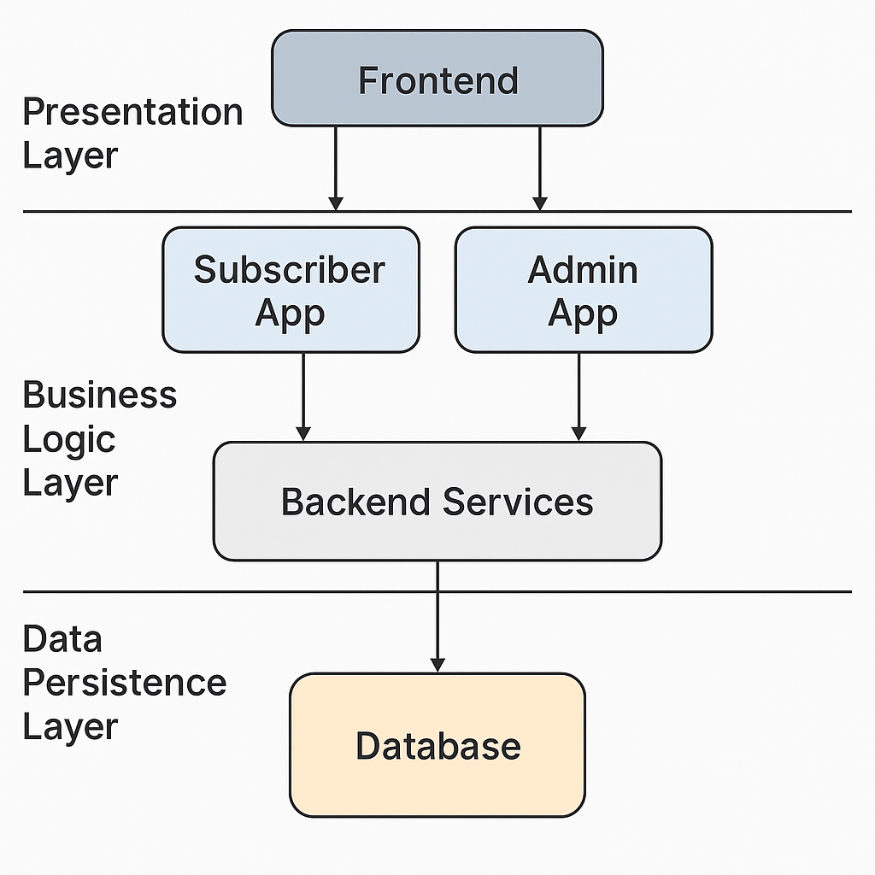
SYSTEM ARCHITECTURE
Overall System Design

Slide 6
SYSTEM ARCHITECTURE
Overall System Design
Design Philosophy

Slide 7
SYSTEM ARCHITECTURE
Design Philosophy
Progressive Disclosure and Visual Hierarchy
Visual Language and Colour Psychology
Accessibility and Inclusiveness
Consistency Through a Shared Design System

Slide 8
FIGMA DESIGN

Slide 9
FIGMA DESIGN
- SUBSCRIBER
Subscriber Dashboard
Data Logs (Subscriber View)
Subscriber Home Page
Subscriber Settings Page

Slide 10
FIGMA DESIGN
- SUBSCRIBER
Subscriber Dashboard
Data Logs (Subscriber View)
Subscriber Home Page
Subscriber Settings Page

Slide 11
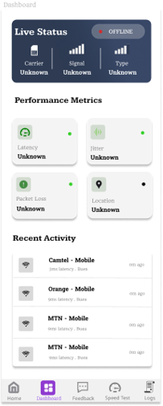
FIGMA DESIGN
- SUBSCRIBER
Subscriber Dashboard

Slide 12
FIGMA DESIGN
- SUBSCRIBER
Subscriber Dashboard
Data Logs (Subscriber View)
Subscriber Home Page
Subscriber Settings Page

Slide 13
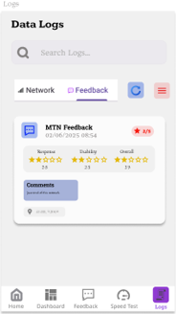
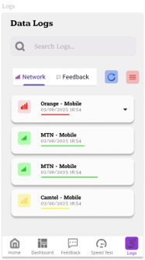
FIGMA DESIGN
- SUBSCRIBER
Data Logs (Subscriber View)

Slide 14
FIGMA DESIGN
- SUBSCRIBER
Subscriber Dashboard
Data Logs (Subscriber View)
Subscriber Home Page
Subscriber Settings Page

Slide 15
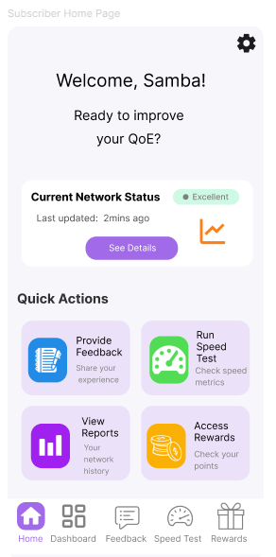
FIGMA DESIGN
- SUBSCRIBER
Subscriber Home Page

Slide 16
FIGMA DESIGN
- SUBSCRIBER
Subscriber Dashboard
Data Logs (Subscriber View)
Subscriber Home Page
Subscriber Settings Page

Slide 17
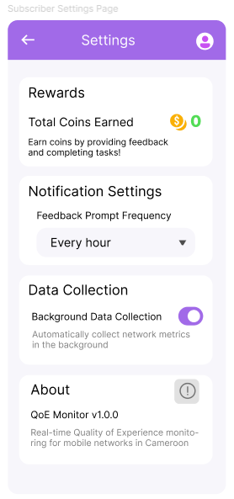
FIGMA DESIGN
- SUBSCRIBER
Subscriber Settings Page

Slide 18
FIGMA DESIGN
- ADMIN
Admin Home Page
Admin Dashboard
Admin Login Page

Slide 19
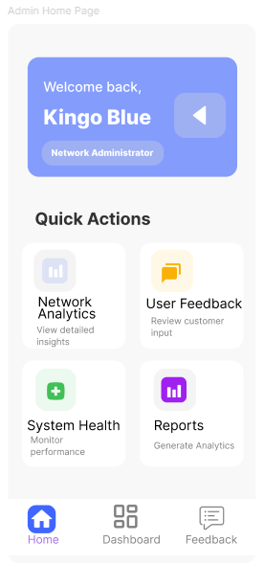
FIGMA DESIGN
- ADMIN
Admin Home Page

Slide 20
FIGMA DESIGN
- ADMIN
Admin Home Page
Admin Dashboard
Admin Login Page

Slide 21
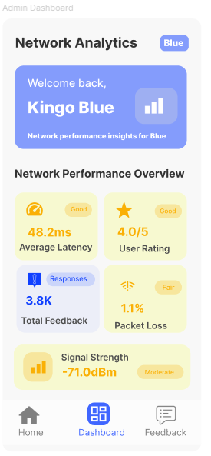
FIGMA DESIGN
- ADMIN
Admin Dashboard

Slide 22
FIGMA DESIGN
- ADMIN
Admin Home Page
Admin Dashboard
Admin Login Page

Slide 23
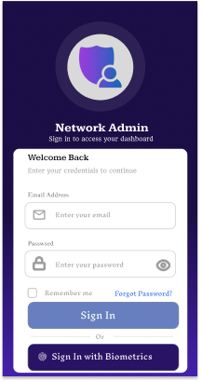
FIGMA DESIGN
- ADMIN
Admin Login Page

Slide 24
IMPLEMENTATION SUBSCRIBER APPLICATION

Slide 25
IMPLEMENTATION SUBSCRIBER APPLICATION
Home Screen Implementation
Dashboard Screen Development
Feedback Collection and User Interface
Settings and Privacy Management
View Logs and Feedback Screen

Slide 26
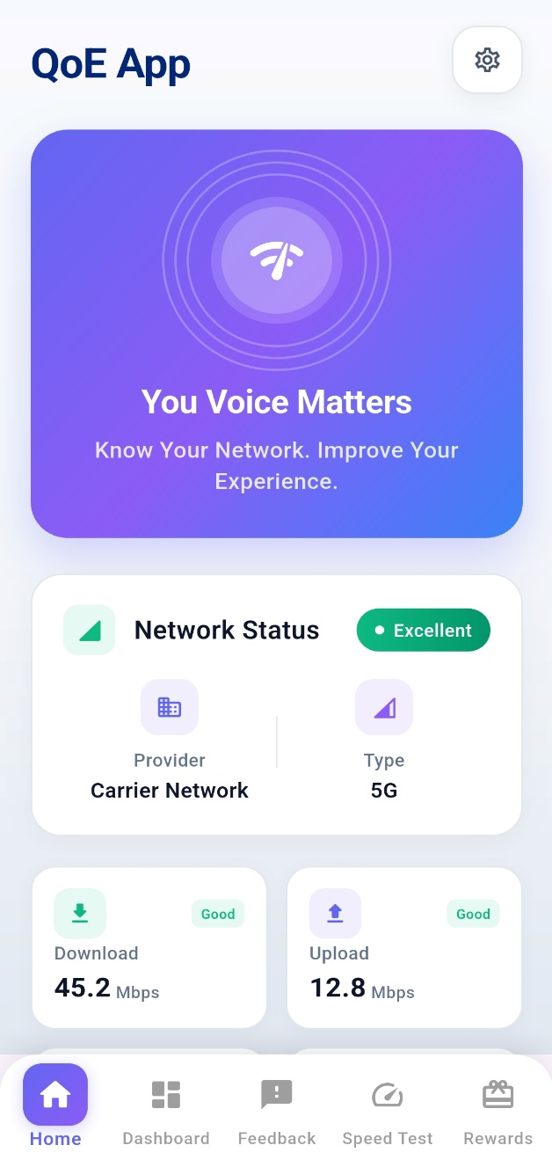
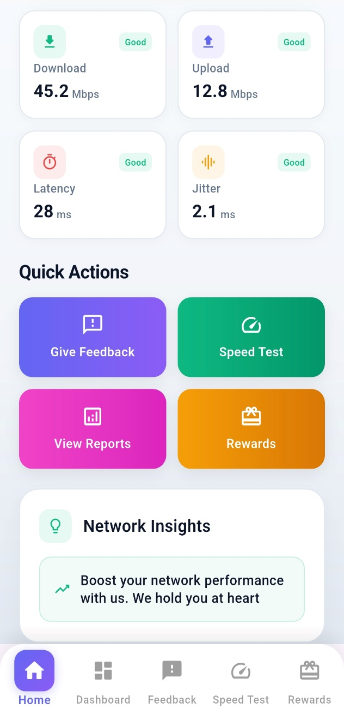
Implementation Subscriber Application
Home Screen Implementation

Slide 27
Implementation Subscriber Application
Home Screen Implementation
Dashboard Screen Development
Feedback Collection and User Interface
Settings and Privacy Management
View Logs and Feedback Screen

Slide 28
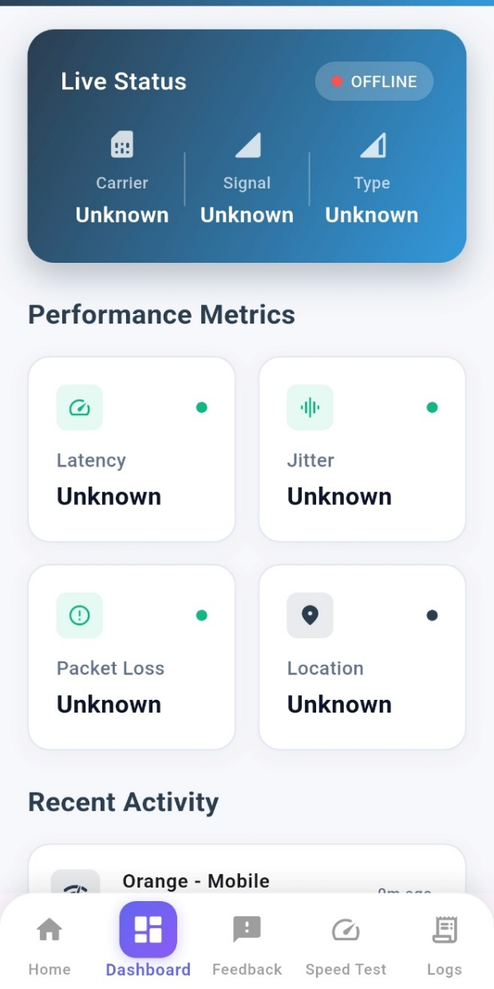
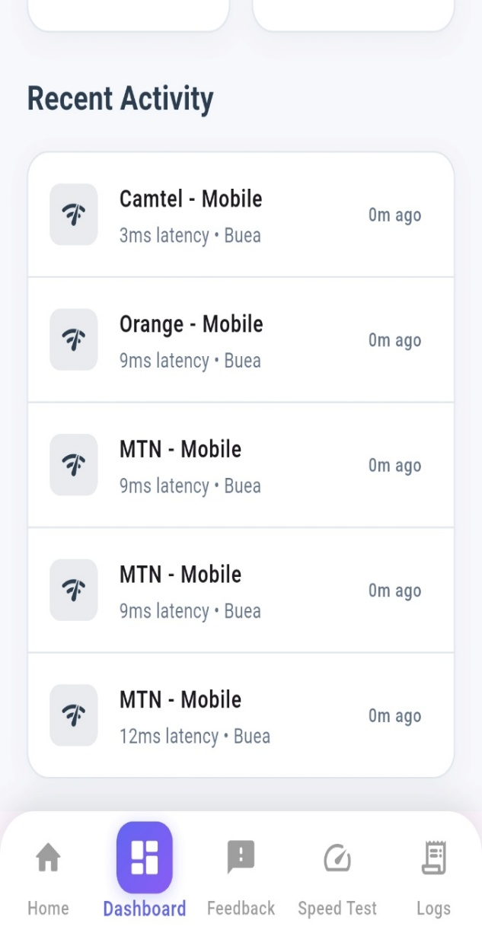
Implementation Subscriber Application
Dashboard Screen Development

Slide 29
Implementation Subscriber Application
Home Screen Implementation
Dashboard Screen Development
Feedback Collection and User Interface
Settings and Privacy Management
View Logs and Feedback Screen

Slide 30
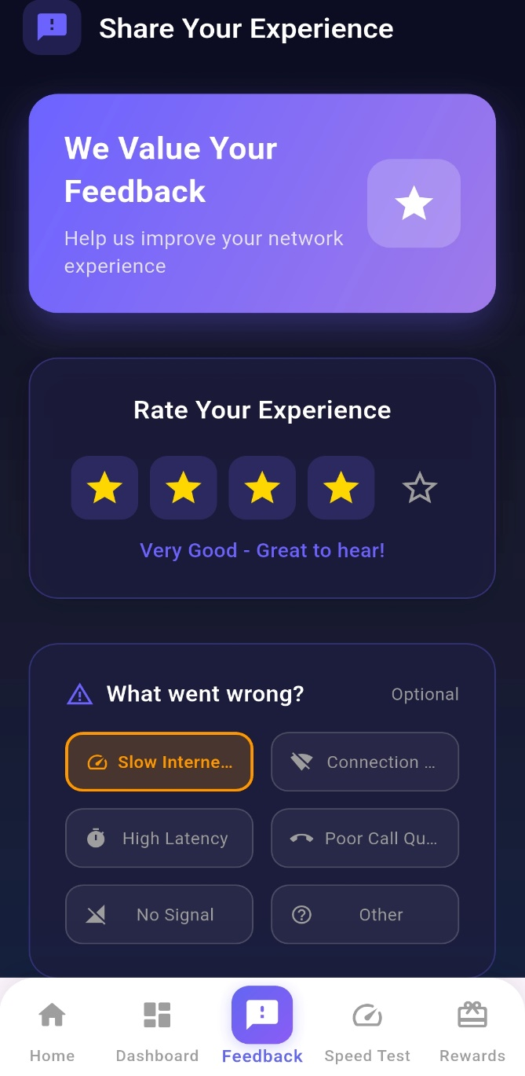
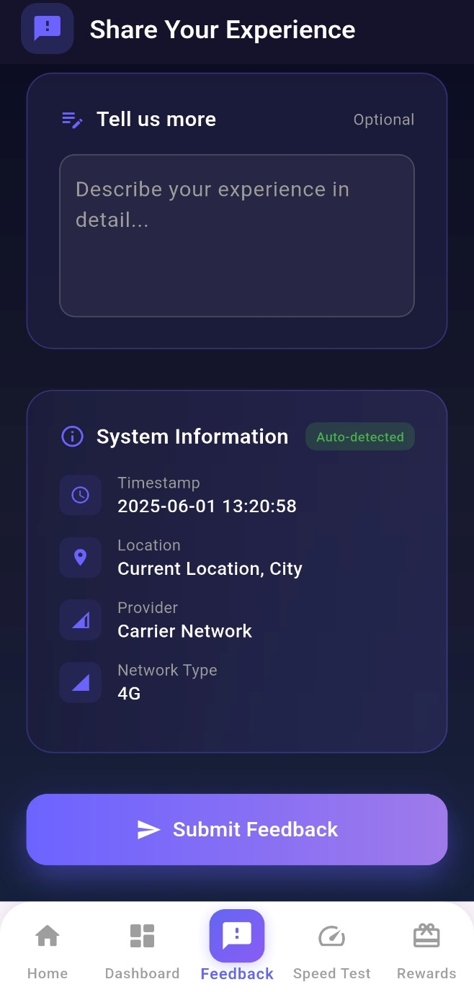
Implementation Subscriber Application
Feedback Collection and User Interface

Slide 31
Implementation Subscriber Application
Home Screen Implementation
Dashboard Screen Development
Feedback Collection and User Interface
Settings and Privacy Management
View Logs and Feedback Screen

Slide 32
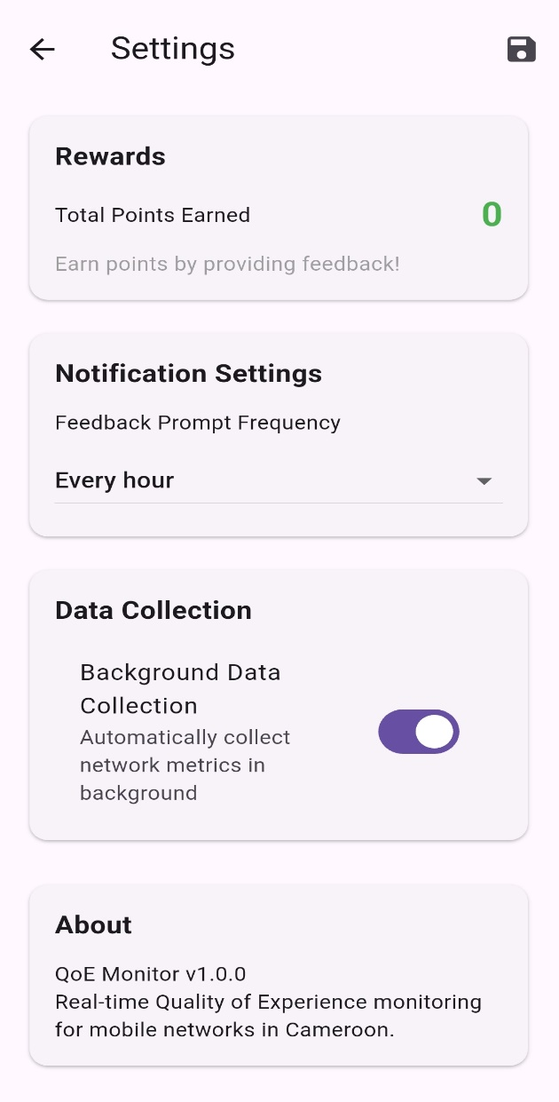
Implementation Subscriber Application
Settings and Privacy Management

Slide 33
Implementation Subscriber Application
Home Screen Implementation
Dashboard Screen Development
Feedback Collection and User Interface
Settings and Privacy Management
View Logs and Feedback Screen

Slide 34
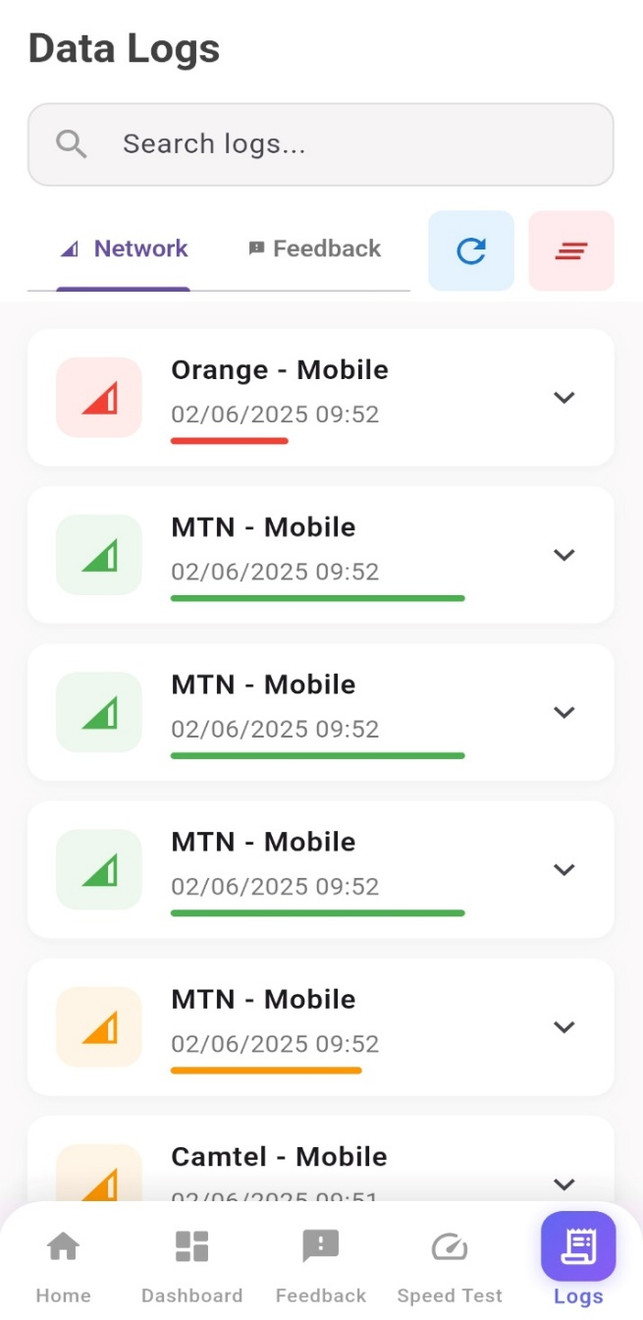
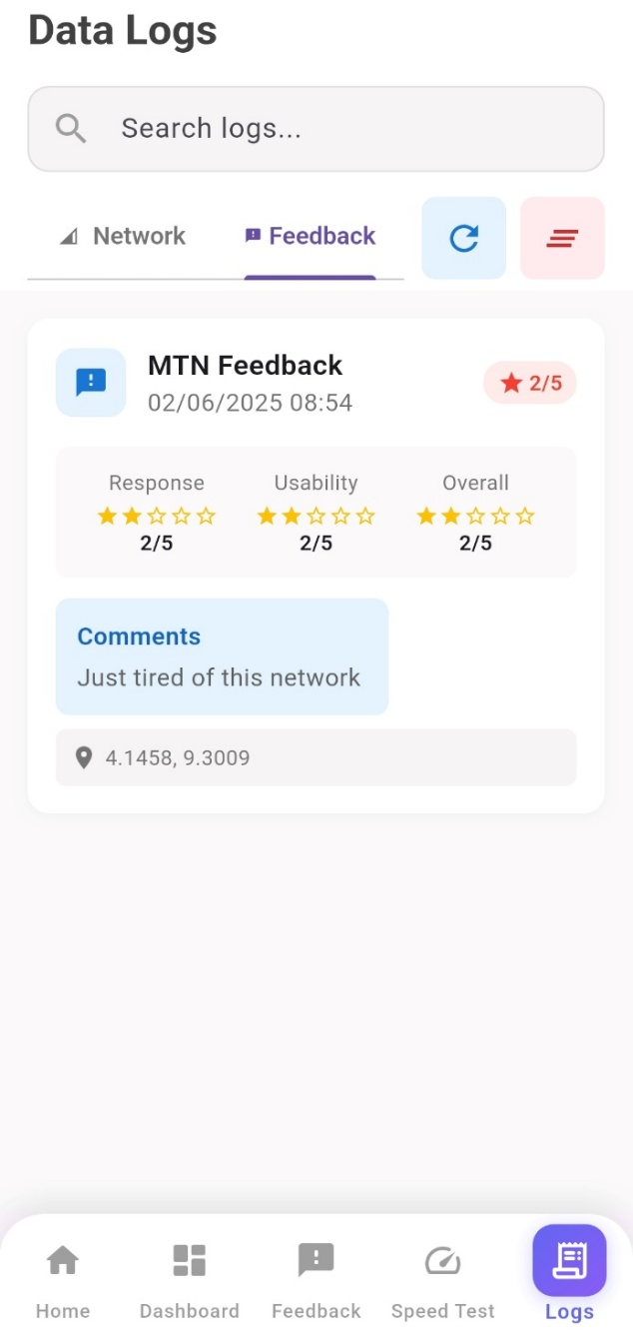
Implementation Subscriber Application
View Logs and Feedback Screen

Slide 35
IMPLEMENTATION ADMINISTRATOR APPLICATION

Slide 36
IMPLEMENTATION ADMINISTRATOR APPLICATION
Login Screen and Password Management
Administrative Dashboard Development
Feedback Management and Analysis Interface
Data Export and Reporting Capabilities

Slide 37
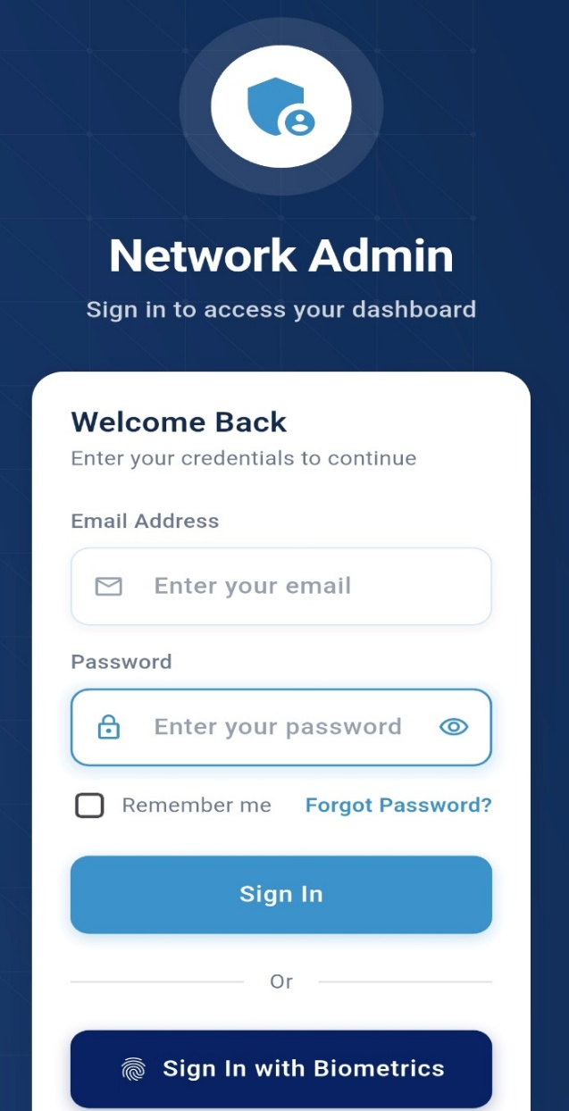
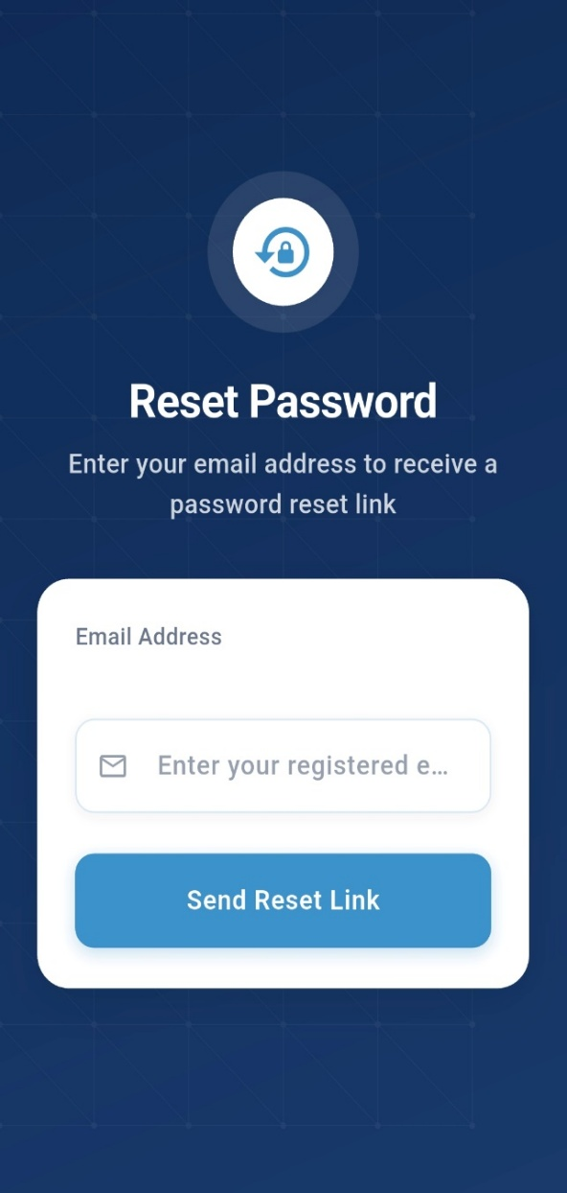
IMPLEMENTATION ADMINISTRATOR APPLICATION
Login Screen and Password Management

Slide 38
IMPLEMENTATION ADMINISTRATOR APPLICATION
Login Screen and Password Management
Administrative Dashboard Development
Feedback Management and Analysis Interface
Data Export and Reporting Capabilities

Slide 39
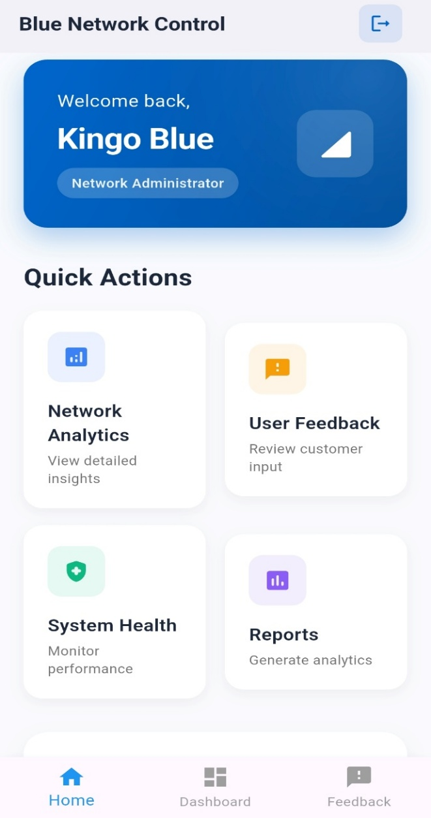
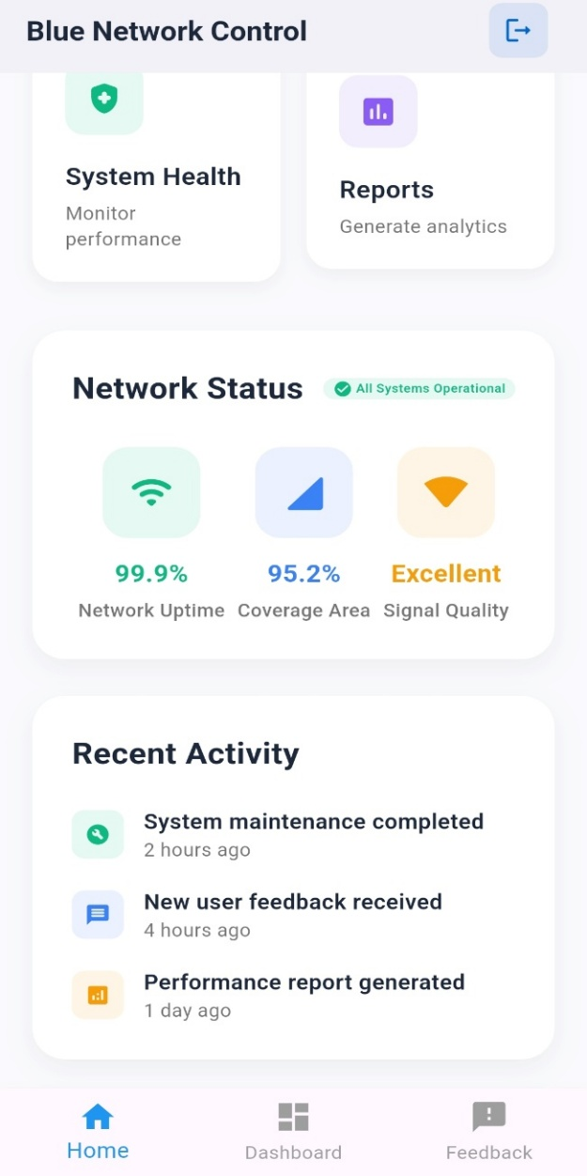
IMPLEMENTATION ADMINISTRATOR APPLICATION
Administrative Dashboard Development

Slide 40
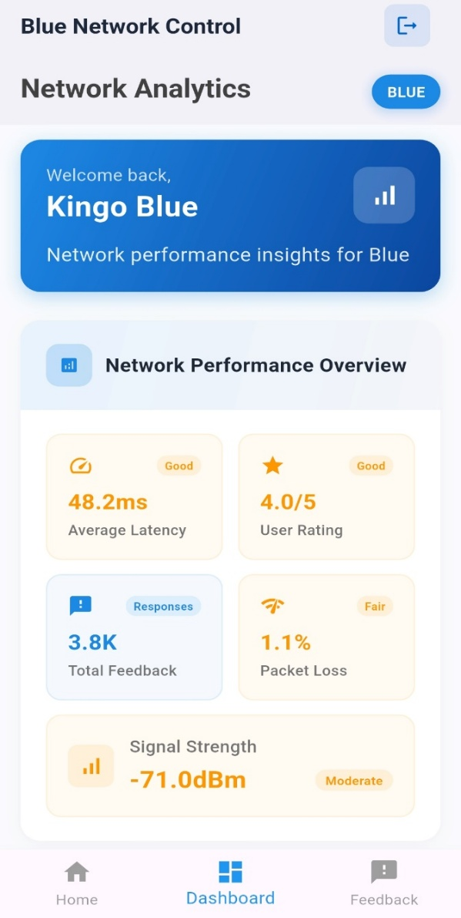
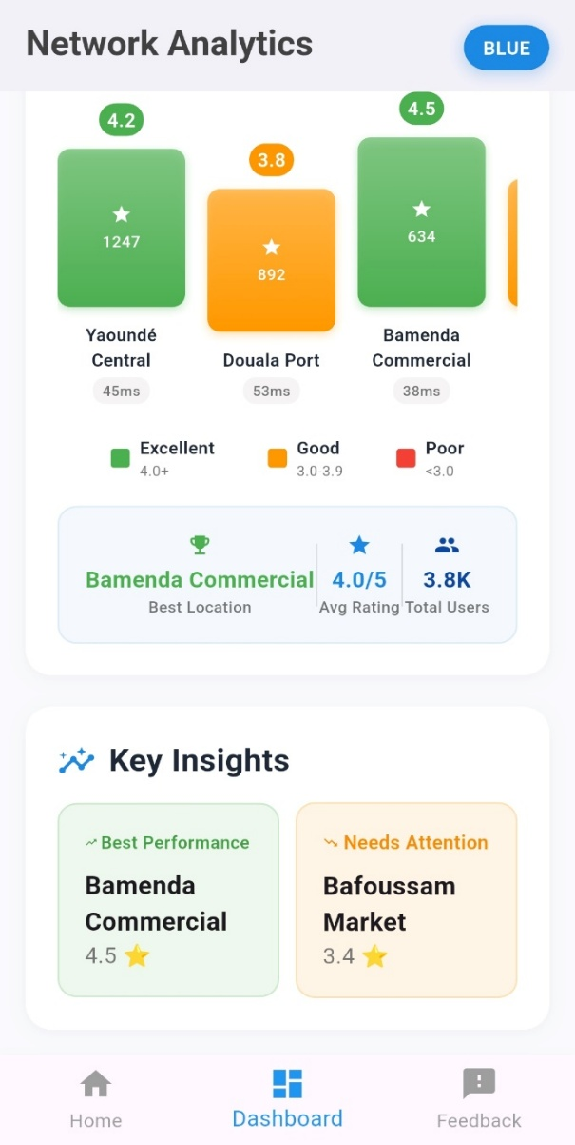
IMPLEMENTATION ADMINISTRATOR APPLICATION
Administrative Dashboard Development

Slide 41
Implementation Administrator Application
Login Screen and Password Management
Administrative Dashboard Development
Feedback Management and Analysis Interface
Data Export and Reporting Capabilities

Slide 42
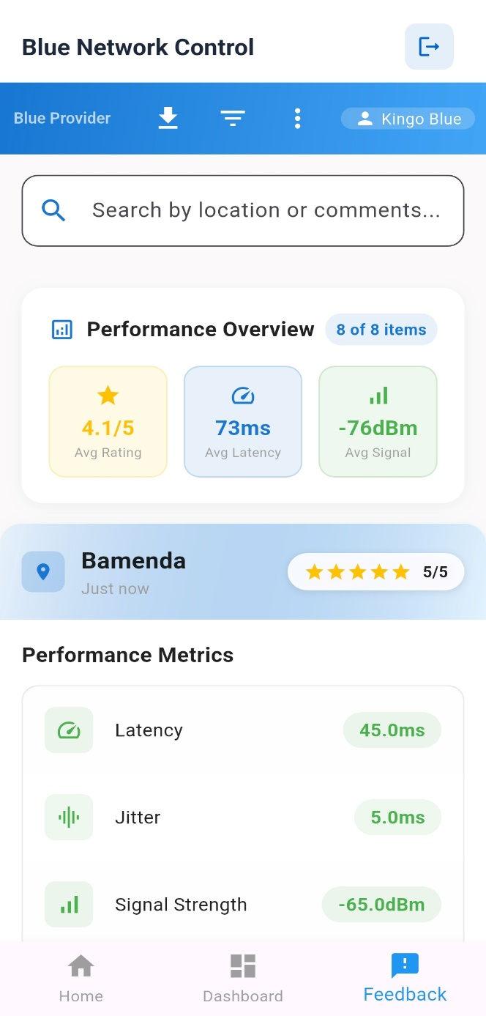
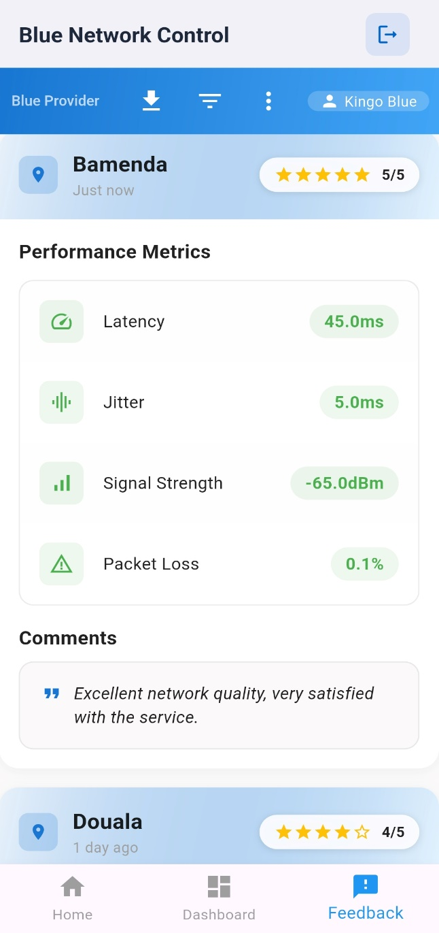
Implementation Administrator Application
Feedback Management and Analysis Interface

Slide 43
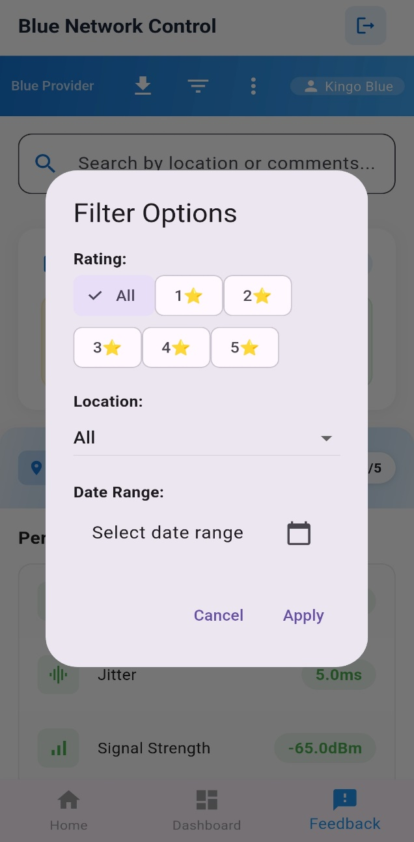
Implementation Administrator Application
Feedback Management and Analysis Interface

Slide 44
Implementation Administrator Application
Login Screen and Password Management
Administrative Dashboard Development
Feedback Management and Analysis Interface
Data Export and Reporting Capabilities

Slide 45
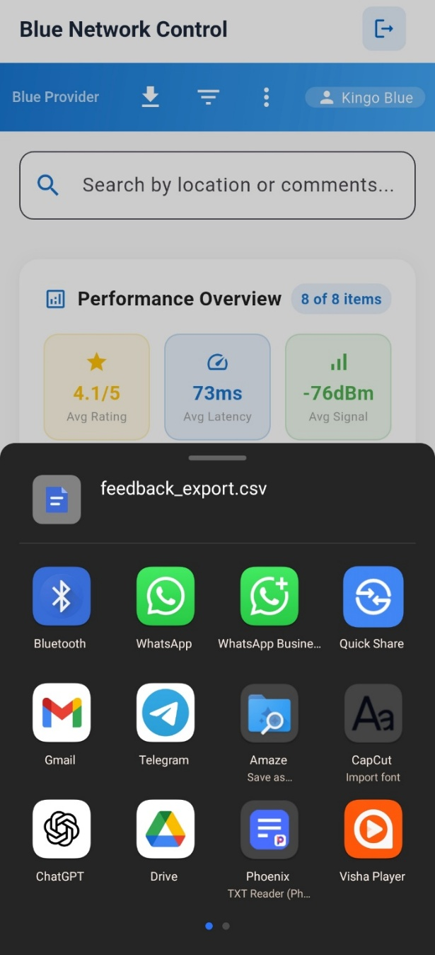
Implementation Administrator Application
Data Export and Reporting Capabilities

Slide 46
FUTURE ENHANCEMENT & CONCLUTION

Slide 47
FUTURE ENHANCEMENT & CONCLUTION

